Slide 1


http://www.comp.nus.edu.sg/~cs2100/
Lecture #11
The Processor: Datapath

Slide 2
Lecture #11a: Processor: Datapath
The Complete Datapath!
Brief Recap
From C to Execution
3.1 Writing C Program
3.2 Compiling to MIPS
3.3 Assembling to Binaries
3.4 Execution (Datapath)

Slide 3
Complete Datapath
Instruction
Memory
PC
Add
MUX
Instruction
4
Left Shift 2-bit
Add
Address
PCSrc
ALUcontrol
Inst [25:21]
5
4
RR1
RD1
Inst [20:16]
5
RR2
is0?
MemWrite
Register
File
ALUSrc
ALU
opcode
31:26
rs
25:21
rt
20:16
rd
15:11
shamt
10:6
5
000000
01001
01010
01000
funct
5:0
WR
ALU
result
00000
MUX
100000
Address
RD2
MUX
WD
Data
Memory
MemToReg
Inst [15:11]
RegWrite
Read
Data
MUX
RegDst
Write
Data
Inst [15:0]
Sign Extend
MemRead

Slide 4
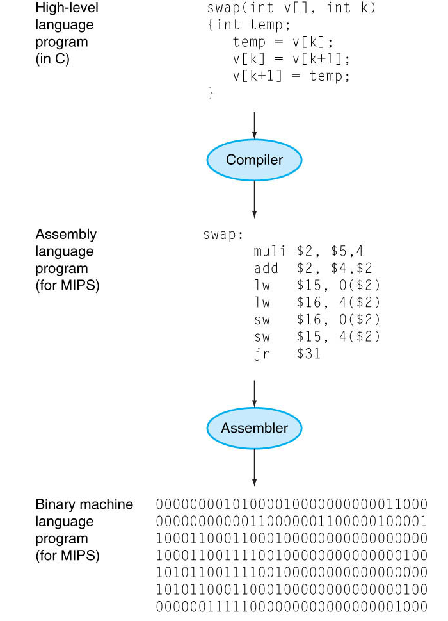
2. Brief Recap
Lecture #7, Slide 4
Write program in high-level language (e.g., C)
if(x != 0) { a[0] = a[1] + x;
}

Slide 5
2. Brief Recap
Lecture #7, Slide 4
Compiler translates to assembly language (e.g., MIPS)
beq $16, $0, Else
lw $8, 4($17) add $8, $8, $16
sw $8, 0($17)
Else:

Slide 6
2. Brief Recap
Lecture #7, Slide 4
Assembler translates to machine code (i.e., binaries)
0001 0010 0000 0000
0000 0000 0000 0011
1000 1110 0010 1000
0000 0000 0000 0100
0000 0010 0000 1000
0100 0000 0001 0100
1010 1110 0010 1000
0000 0000 0000 0000

Slide 7
2. Brief Recap
Lecture #7, Slide 4
Processor executes the machine code (i.e., binaries)
PC
4
Instruction
Memory
PCSrc
5
ALUcontrol
5
ALUSrc
MemWrite
5
Register
File
ALU
Data
Memory
MemToReg
RegDst
RegWrite
MemRead

Slide 8
3. From C to Execution
We play the role of Programmer, Compiler, Assembler, and Processor
Program:
if(x != 0) { a[0] = a[1] + x; }
Programmer:
Show the workflow of compiling, assembling, and executing C program
Compiler:
Show how the program is compiled into MIPS
Assembler:
Show how the MIPS is translated into binaries
Processor:
Show how the datapath is activated in the processor

Slide 9
3.1 Writing C Program
Edit, Compile, Execute: Lecture #2, Slide 5
Source code
Compile
Execute
Edit
Edit
produces
recap.c
if(x != 0) { a[0] =
a[1] + x;
}
eg: vim recap.c
Executable code
Compile
produces
Cannot compile?
a.out
eg: gcc recap.c
Incorrect result?
Program output
Execute
produces
eg: a.out
No output expected

Slide 10
recap.c
if(x != 0) { a[0] =
a[1] + x;
}
3.2 Compiling to MIPS
Key Idea #1: Compilation is a structured process
if(x != 0) { a[0] = a[1] + x; }
Each structure can be compiled independently
Inner Structure
Outer Structure
a[0] = a[1] + x;
if(x != 0) {
}

Slide 11
recap.c
if(x != 0) { a[0] =
a[1] + x;
}
3.2 Compiling to MIPS
Key Idea #2: Variable-to-Register Mapping
if(x != 0) { a[0] = a[1] + x; }
Let the mapping be:
Variable | Register Name | Register Number
x | $s0 | $16
a | $s1 | $17

Slide 12
Mapping:
x: $16
a: $17
recap.c
if(x != 0) { a[0] =
a[1] + x;
}
3.2 Compiling to MIPS
Common Technique #1: Invert the condition for shorter code (Lecture #8, Slide 22)
Outer Structure
Outer MIPS Code
if(x != 0) {
}
beq $16, $0, Else
# Inner Structure
Else:

Slide 13
Mapping:
x: $16
a: $17
$t1: $8
recap.c
if(x != 0) { a[0] =
a[1] + x;
}
3.2 Compiling to MIPS
Common Technique #2: Break complex operations, use temp register (Lecture #7, Slide 29)
Inner Structure
Simplified Inner Structure
a[0] = a[1] + x;
$t1 = a[1];
$t1 = $t1 + x;
a[0] = $t1;

Slide 14
Mapping:
x: $16
a: $17
$t1: $8
recap.c
if(x != 0) { a[0] =
a[1] + x;
}
3.2 Compiling to MIPS
Common Technique #3: Array access is lw, array update is sw (Lecture #8, Slide 13)
Simplified Inner Structure
Inner MIPS Code
$t1 = a[1];
$t1 = $t1 + x;
a[0] = $t1;
lw $8, 4($17) add $8, $8, $16
sw $8, 0($17)

Slide 15
Mapping:
x: $16
a: $17
$t1: $8
recap.c
if(x != 0) { a[0] =
a[1] + x;
}
3.2 Compiling to MIPS
Common Error #1: Assume that the address of the next word can be found by incrementing the address in a register by 1 instead of by the word size in bytes
Example:
$t1 = a[1]; is translated to lw $8, 4($17) instead of lw $8, 1($17)

Slide 16
Mapping:
x: $16
a: $17
$t1: $8
recap.c
if(x != 0) { a[0] =
a[1] + x;
}
3.2 Compiling to MIPS
Last Step: Combine the two structures logically
Inner MIPS Code
Outer MIPS Code
lw $8, 4($17) add $8, $8, $16
sw $8, 0($17)
beq $16, $0, Else
# Inner Structure
Else:
Combined MIPS Code
beq $16, $0, Else
lw $8, 4($17) add $8, $8, $16
sw $8, 0($17)
Else:

Slide 17
recap.mips
beq $16, $0, Else
lw $8, 4($17) add $8, $8, $16
sw $8, 0($17)
Else:
3.3 Assembling to Binary
Instruction Types Used:
R-Format: (Lecture #9, Slide 8)
opcode $rd, $rs, $rt
I-Format: (Lecture #9, Slide 14)
opcode $rt, $rs, immediate
Branch: (Lecture #9, Slide 22)
Uses I-Format
PC = (PC + 4) + (immediate × 4)
6
5
5
5
5
6
opcode
rs
rt
rd
shamt
funct
6
5
5
16
opcode
rs
rt
immediate

Slide 18
recap.mips
beq $16, $0, Else
lw $8, 4($17) add $8, $8, $16
sw $8, 0($17)
Else:
3.3 Assembling to Binary
beq $16, $0, Else
Compute immediate value (Lecture #9, Slide 27)
immediate = 3
Fill in fields (refer to MIPS Reference Data)
Convert to binary
6
5
5
16
4
16
0
3
000100
10000
00000
0000000000000011
beq $16, $0, Else
lw $8, 4($17) add $8, $8, $16
sw $8, 0($17)
Else:
+3

Slide 19
recap.mips
beq $16, $0, Else
lw $8, 4($17) add $8, $8, $16
sw $8, 0($17)
Else:
3.3 Assembling to Binary
lw $8, 4($17)
Fill in fields (refer to MIPS Reference Data)
Convert to binary
6
5
5
16
35
17
8
4
100011
10001
01000
0000000000000100
0001 0010 0000 0000 0000 0000 0000 0011
lw $8, 4($17) add $8, $8, $16
sw $8, 0($17)
Else:

Slide 20
recap.mips
beq $16, $0, Else
lw $8, 4($17) add $8, $8, $16
sw $8, 0($17)
Else:
3.3 Assembling to Binary
add $8, $8, $16
Fill in fields (refer to MIPS Reference Data)
Convert to binary
6
5
5
5
5
6
0
8
16
8
0
32
000000
01000
10000
01000
00000
100000
0001 0010 0000 0000 0000 0000 0000 0011
1000 1110 0010 1000 0000 0000 0000 0100 add $8, $8, $16
sw $8, 0($17)
Else:

Slide 21
recap.mips
beq $16, $0, Else
lw $8, 4($17) add $8, $8, $16
sw $8, 0($17)
Else:
3.3 Assembling to Binary
sw $8, 0($17)
Fill in fields (refer to MIPS Reference Data)
Convert to binary
6
5
5
16
43
17
8
0
101011
10001
01000
0000000000000000
0001 0010 0000 0000 0000 0000 0000 0011
1000 1110 0010 1000 0000 0000 0000 0100 0000 0001 0001 0000 0100 0000 0010 0000
sw $8, 0($17)
Else:

Slide 22
recap.mips
beq $16, $0, Else
lw $8, 4($17) add $8, $8, $16
sw $8, 0($17)
Else:
3.3 Assembling to Binary
Final Binary
Hard to read?
Don’t worry, this is intended for machine not for human!
0001 0010 0000 0000 0000 0000 0000 0011
1000 1110 0010 1000 0000 0000 0000 0100 0000 0001 0001 0000 0100 0000 0010 0000
1010 1110 0010 1000 0000 0000 0000 0000

Slide 23
3.4 Execution (Datapath)
Given the binary
Assume two possible executions:
$16 == $0 (shorter)
$16 != $0 (longer )
Convention:
Fetch: Memory:
Decode: Reg Write:
ALU: Other:
0001 0010 0000 0000 0000 0000 0000 0011
1000 1110 0010 1000 0000 0000 0000 0100 0000 0001 0001 0000 0100 0000 0010 0000
1010 1110 0010 1000 0000 0000 0000 0000

Slide 24
beq $16, $0, Else
Assume $16 == $0
Instruction
Memory
PC
Add
MUX
Instruction
4
Left Shift 2-bit
Add
Address
PCSrc
opcode
31:26
000100
ALUcontrol
rs
25:21
10000
Inst [25:21]
5
$16
4
RR1
RD1
5
$0
R[$16]
TRUE
MemWrite
Inst [20:16]
RR2
is0?
rt
20:16
0000
Register
File
ALU
5
WR
ALUSrc
MUX
ALU
result
Address
RD2
MUX
WD
R[$0]
Data
Memory
MemToReg
Inst [15:11]
immediate
10:6
RegWrite
Read
Data
MUX
0000000000000011
RegDst
Write
Data
Inst [15:0]
Sign Extend
MemRead

Slide 25
beq $16, $0, Else
Assume $16 != $0
Instruction
Memory
PC
Add
MUX
Instruction
4
Left Shift 2-bit
Add
Address
PCSrc
opcode
31:26
000100
ALUcontrol
rs
25:21
10000
Inst [25:21]
5
$16
4
RR1
RD1
5
$0
R[$16]
is0?
FALSE
MemWrite
rt
20:16
Inst [20:16]
RR2
0000
Register
File
ALUSrc
ALU
MUX
5
WR
ALU
result
MUX
Address
RD2
R[$0]
WD
Data
Memory
MemToReg
Inst [15:11]
immediate
10:6
RegWrite
Read
Data
MUX
0000000000000011
RegDst
Write
Data
Inst [15:0]
Sign Extend
MemRead

Slide 26
lw $8, 4($17)
Assume $16 != $0
Instruction
Memory
PC
Add
MUX
Instruction
4
Left Shift 2-bit
Add
Address
PCSrc
opcode
31:26
100011
ALUcontrol
rs
25:21
10001
Inst [25:21]
5
$17
4
RR1
RD1
5
R[$17]
is0?
MemWrite
rt
20:16
Inst [20:16]
RR2
01000
$8
Register
File
ALUSrc
ALU
MUX
5
WR
ALU
result
R[$17]+4
MUX
Address
M[R[$17]+4]
RD2
4
WD
Data
Memory
MemToReg
Inst [15:11]
immediate
10:6
RegWrite
Read
Data
MUX
0000000000000100
RegDst
Write
Data
M[R[$17]+4]
Inst [15:0]
Sign Extend
MemRead

Slide 27
add $8, $8, $16
Assume $16 != $0
Instruction
Memory
PC
Add
MUX
Instruction
4
Left Shift 2-bit
Add
Address
PCSrc
ALUcontrol
Inst [25:21]
5
$8
4
RR1
RD1
5
$16
R[$18]
is0?
MemWrite
Inst [20:16]
RR2
$8
Register
File
ALUSrc
ALU
opcode
31:26
rs
25:21
rt
20:16
rd
15:11
shamt
10:6
5
000000
01000
10000
01000
funct
5:0
WR
ALU
result
00000
100000
MUX
Address
R[$18]+R[$16]
RD2
MUX
WD
R[$16]
Data
Memory
MemToReg
Inst [15:11]
RegWrite
Read
Data
MUX
RegDst
Write
Data
Inst [15:0]
Sign Extend
MemRead

Slide 28
sw $8, 0($17)
Assume $16 != $0
Instruction
Memory
PC
Add
MUX
Instruction
4
Left Shift 2-bit
Add
Address
PCSrc
opcode
31:26
101011
ALUcontrol
rs
25:21
10001
Inst [25:21]
5
4
RR1
RD1
Inst [20:16]
5
RR2
is0?
MemWrite
rt
20:16
01000
Register
File
ALU
5
WR
ALUSrc
MUX
ALU
result
Address
RD2
MUX
WD
Data
Memory
MemToReg
Inst [15:11]
immediate
10:6
RegWrite
Read
Data
MUX
0000000000000000
RegDst
Write
Data
Inst [15:0]
Sign Extend
MemRead

Slide 29
End of File

